Slide 1
Fallback Mechanisms for Connection Loss in Single-Page Applications

Slide 2
From web sites to web applications

Slide 3
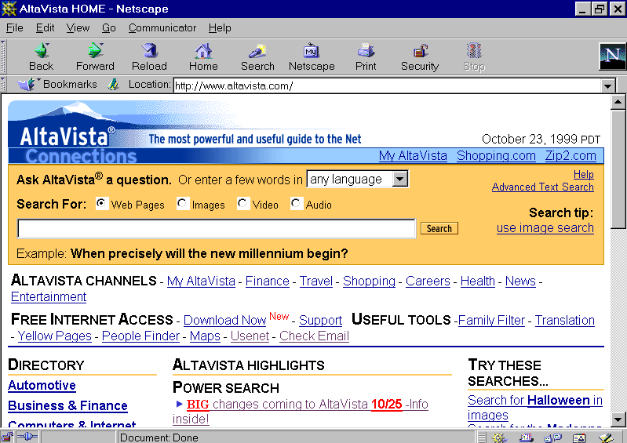
AltaVista in 1999
Notes:
Completely tied to the server
Minimal interaction

Slide 4
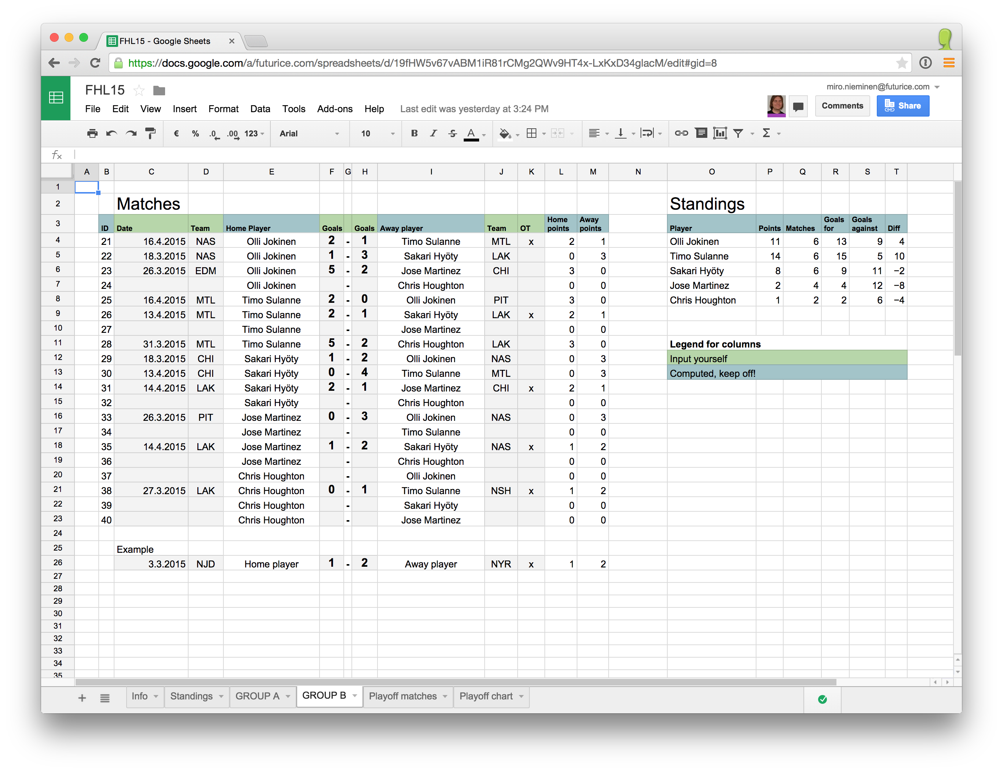
Google Spreadsheet in 2015
Notes:
Reactive -> you can see effects of the changes instantly
The browser has more business logic

Slide 5
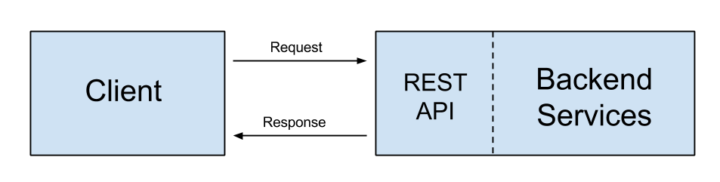
.
Notes:
Client aka the browser
Usage of API’s, fetch only the data, not the presentation format

Slide 6
“Write once, run everywhere”
Notes:
PROPER PLATFORM for app development,
Massive amount of users,
no deployment problems on installation and version upgrades

Slide 7

Notes:
“mission critical” from csc.com (well maybe not this),
When used via mobile broadband, “the last mile” of connection is random by its nature, especially outside city centres
Also the UX aspect -> makes usage of application more convenient,
In order to implement mission critical stuff, we have to handle this
Free the user, Remove the strings attached to the server

Slide 8
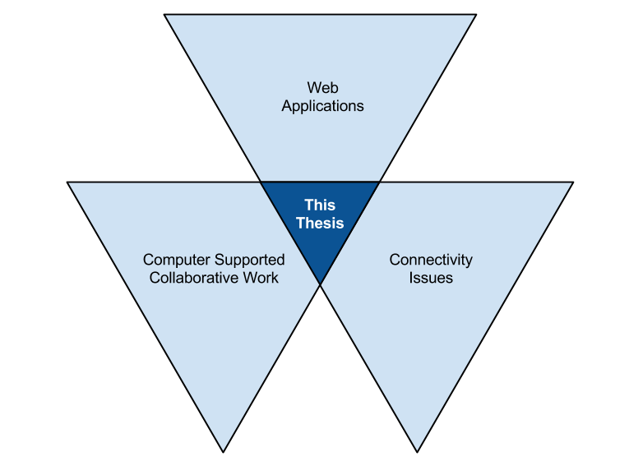
Notes:
CSCW – how we can help people to work together with “computer support”
WEB APPLICATIONS – form of computer support investigated on this thesis
C ISSUES – how this affects this combination, and how the effect it causes can be handled

Slide 9

Case: Päikky
“Kindergarten ERP”
Notes:
Kindergarten management tool

Slide 10
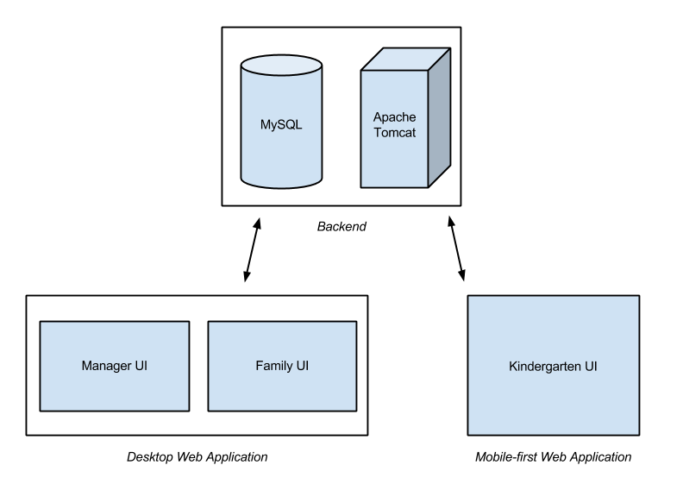
Notes:
Kindergarten management tool

Slide 11
// Demo: overview
Notes:
Overview on the kindergarten client

Slide 12
“This needs to work also without Internet connection!”
Notes:
In the spring 2013 there were rollouts to kindergartens which had very unreliable mobile broadband coverage
-> the need for offline support emerged
(offline would’ve been nice since then the start, but startup company, MVP, business model validation, etc etc etc)

Slide 13
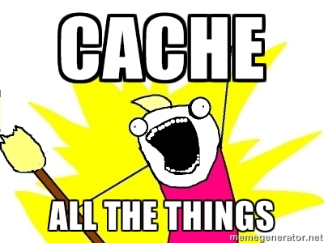
Notes:
CACHE HEADER for images and other resources that change from time to time APPLICATION CACHE via CACHE MANIFEST for static resources
LOCAL STORAGE for API DATA CACHE

Slide 14

Notes:
CACHE HEADER for images and other resources that change from time to time APPLICATION CACHE via CACHE MANIFEST for static resources
LOCAL STORAGE for API DATA CACHE

Slide 15
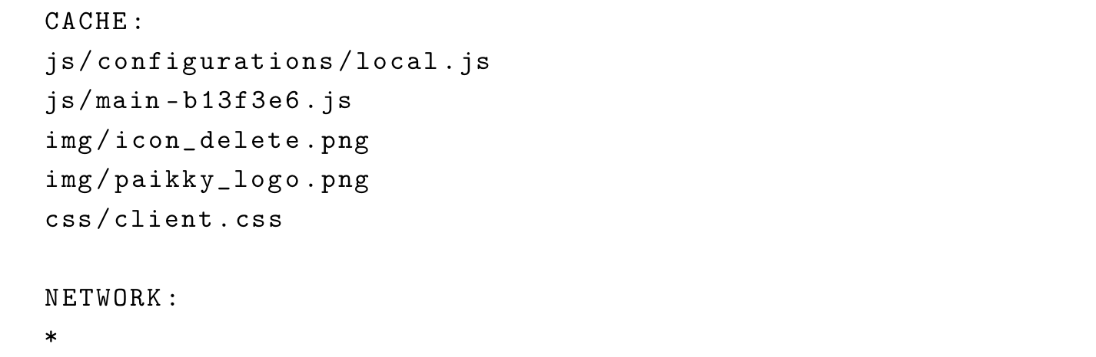
Notes:
CACHE HEADER for images and other resources that change from time to time APPLICATION CACHE via CACHE MANIFEST for static resources
LOCAL STORAGE for API DATA CACHE

Slide 16
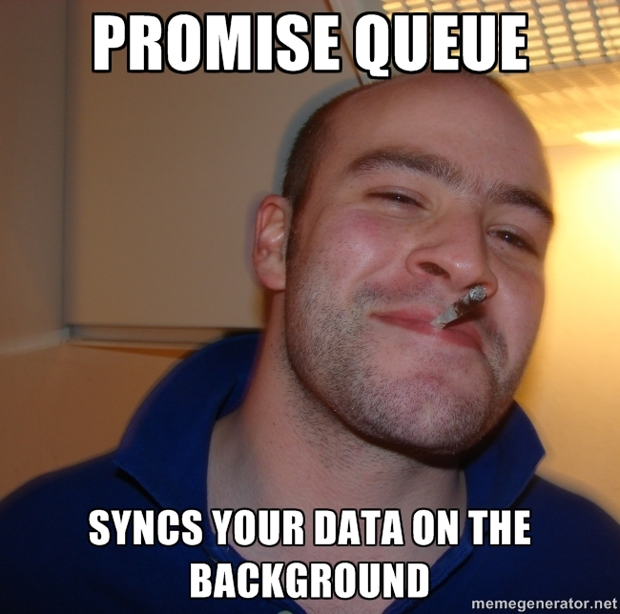
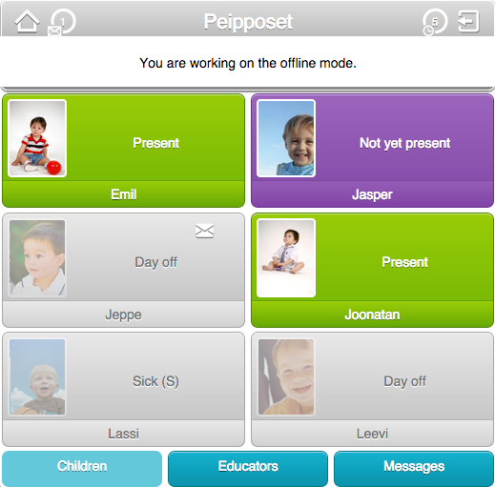
Notes:
Cacheing isn’t enough – you have to support some functionalities besides just browsing through the views
-> means duplicate business logic also on the browser!

Slide 17
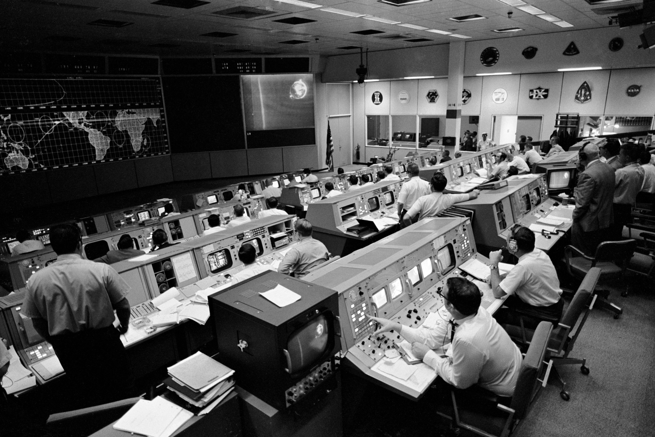
Notes:
OBSERVE CONNECTION QUALITY, well it’s not actually rocket science, just catch-case for AJAX errors
While in OFFLINE-MODE, ping the backend until connectivity is reached again

Slide 18
// Demo: offline mode
Notes:
Overview on the kindergarten client

Slide 19
Lessons learned

Slide 20
Support only the essential features while offline
Notes:
Päikky: Massive UX improvements even when the key features were offline supported

Slide 21
Prepare for offline support
Notes:
Probably It is coming in some point anyways
Take it into account on the architecture
KEEP IT IN MIND

Slide 22
Utilize browser cache(s) as much as possible
Notes:
You can take benefit from it even if there is no need for offline support

Slide 23
Bonus: Hide the connection status from the user…?
Notes:
You can take benefit from it even if there is no need for offline support

Slide 24

…actually, no.
Average user doesn’t know how the client-server –model works.
(Should they be educated about it?)

Slide 25
Questions?

Slide 26

miro.nieminen@futurice.com @murolies mukavait.com

